Slide 1
Aim: How can we build projects with teams and computers?
Do Now: What sorts of things could people make with computers?
Write as many ideas as you can in 1 minute.

Slide 2
CS Principles
Lesson 00.00 - Iterative Development

Slide 3
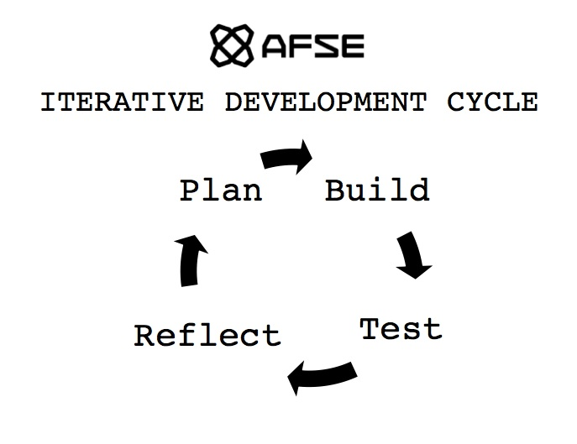

Slide 5
The Big Ideas of CS Principles
Creativity
Abstraction
Algorithms
Data
Programming
Internet
Global Impact

Slide 6
Seating Charts
Section 1
Section 2
Section 3
Section 4

Slide 7
Classroom Norms
Games: If you build it, you can play it.
Music/Headphones: Not in your best interest, trust us.
Lateness: If your not here, you’re missing something.
Bathroom: We need to be able to trust you.

Slide 8


Slide 9


Slide 10


Slide 11
Agenda
Do Now (3 mins)
Mini Lesson (10 mins)
Activity 1: Plan (13 mins)
Activity 2: Build (15 mins)
Activity 3: Test (10 mins)
Activity 4: Reflect (6 mins)
Presentations (16 mins)
Closing/Clean up (5 mins)

Slide 12
Today’s Mini Hackathon
We’re going to be working through one iteration of the Development Cycle that we use in IntroCS, so we’ll be moving quickly. At some point you may not have fully completed a step. That’s OK. Please work as quickly as you can, and transition with the class after time is up for each section.
Notes:
Note to other teachers: Sophomores have seen the Iterative Development Cycle a lot, so there’s no need (or time) to go into detail or define each part of the cycle.

Slide 13
iteration, n.
1. the act of repeating; a repetition.
2. a problem-solving or computational method in which a succession of approximations, each building on the one preceding, is used to solve the problem

Slide 14
Brainstorming
Working with a team to generate ideas about what is possible.

Slide 15
Review the Rules for Brainstorming
1. Defer Judgment. Don’t block someone else’s idea if you don’t like it…put it on the whiteboard and maybe you’ll be able to build on it later.
2. Go for quantity. Getting to 100 ideas is better than 10, no matter what you initially think about the “quality”. Try setting a goal for the number of ideas you’ll get to in a certain amount of time to provide some stoke.
3. One conversation at a time. When different conversations are going on within a team, no one can focus.
4. Be visual. Sketch your ideas out for your teammate. It will communicate them more clearly than words alone, plus you might inspire some crazy new ideas.
5. Headline your idea. Make it quick and sharp, then move on to the next one.
6. Build on the Ideas of others. This leverages the perspectives of diverse teams and can be especially useful when you feel like you’re stuck.
7. Stay on topic. Your idea for an edible cell phone is awesome, but not during a brainstorm on making opera more exciting for children.
8. Encourage wild ideas. The crazier the better…you never know where your team might be able to take it. (See #1 and #6).

Slide 16
Team Brainstorm
Who is your…
Notetaker:
Timekeeper:
Facilitator:

Slide 17
The Problem
Today’s class focuses on Creativity.
Here’s the problem: What sorts of things could people make with computers?

Slide 18
3 min brainstorm
Using the rules of brainstorming, come up with as many different ideas as you can with your team.

Slide 19
Next Step: Build Your Prototype!
prototype: a fast working version of something that you could build
Your goal for the next 12 minutes is to choose one of your ideas for what a computer can make and build your prototype. You may use construction paper, markers, colored pencils, scissors, and/or glue sticks.

Slide 20
Test Your Prototype
1) Turn to the group adjacent to your team. Pitch your idea in 60 seconds. This is called an “elevator pitch.”
2) Teams complete a feedback slip to leave with the other team.
Warm feedback: I like this idea because …
Cool feedback: Maybe you could try …

Slide 21
Reflect
You have 6 minutes to incorporate your feedback from the other group and to prepare for your final presentation. Each group will have one minute to share with the class.

Slide 22

Presentations
Give us your elevator pitch. Each group gets 60 seconds.
Success!

Slide 23

In Closing: 3 Words
Share three words that summarize your takeaway from today’s Troubleshooting Workshop. What did you learn about yourself as a troubleshooter or problem solver? What is your takeaway from working as part of a team?

Slide 24
Team Task: Clean Up!
All supplies must be put away and desks and floors cleared of any trash before you may be dismissed.

Slide 25
Section 1 Seating Chart

Slide 26
Section 2 Seating Chart

Slide 27
Section 3 Seating Chart

Slide 28
Section 4 Seating Chart

